Slide 1
Bitcoin Price Movement Clustering
Under the Guidance of
Prof. Mahalakshmi C.V
Assistant Professor
Bangalore Institute of Technology
Presented by
1BI22CS411 | Shivakumar

Slide 2
Agenda
Introduction
Problem Statement
Proposed System
Methodology/Algorithm
Tools/Technologies
Implementation
Results
Reflection notes

Slide 3
Introduction
A machine learning task or project that completely deals with the predictions of variations or movement in the price of bitcoin(cryptocurrency). The project mainly focus on the aspects of bitcoin to predict the variations.
Objective: Predict the daily price movement of a cryptocurrency in USD.
Data Features: Date, Opening Price, Highest Price, Lowest Price, Closing Price, Trading Volume, Currency Details.
Target Variable: "Price Movement" (binary: increase or decrease compared to opening price).

Slide 4
Problem Statement
In this machine learning task, the goal is to predict the daily price movement of a cryptocurrency in USD using historical opening and closing prices. The dataset includes essential features such as date, opening, highest, lowest, and closing prices, as well as trading volume and currency details. The target variable, "Price Movement," is binary, indicating whether the closing price increased or decreased compared to the opening price. The approach involves data pre-processing, feature engineering, data splitting, model selection, and model evaluation using Clustering algorithms. The success of the model will be determined by its accuracy in predicting price movements, offering valuable insights for traders and investors aiming to make informed decisions based on anticipated market trends.

Slide 5
Blockchain Technology
Blockchain technology is a decentralized and distributed ledger system that enables secure, transparent, and tamper-resistant record-keeping of transactions across a network of computers. It was initially developed as the underlying technology for the cryptocurrency Bitcoin but has since found applications in various industries.

Slide 6

What is Bitcoin?
Bitcoin is a decentralized digital currency, without a central bank or single administrator, that can be sent from user to user on the peer-to-peer bitcoin network without the need for intermediaries. Transactions are verified by network nodes through cryptography and recorded on a public distributed ledger called a blockchain.

Slide 7
What is machine learning?
Using data and algorithms to build intelligent systems.
Machine learning is a subfield of artificial intelligence (AI) that focus on the development of algorithms and models that enable computers to learn patterns and make predictions or decisions without being explicitly programmed. The core idea behind machine learning is to enable machines to learn from data and improve their performance over time.

Slide 8
Proposed System
Clustering model: Clustering is a type of unsupervised learning where the goal is to group similar data points together based on their features, without the presence of predefined labels. The objective is to discover inherent patterns, similarities, or structures within the data.
These are the algorithms used under the proposal:
Support Vector Machines (SVM)
Random Forest

Slide 9
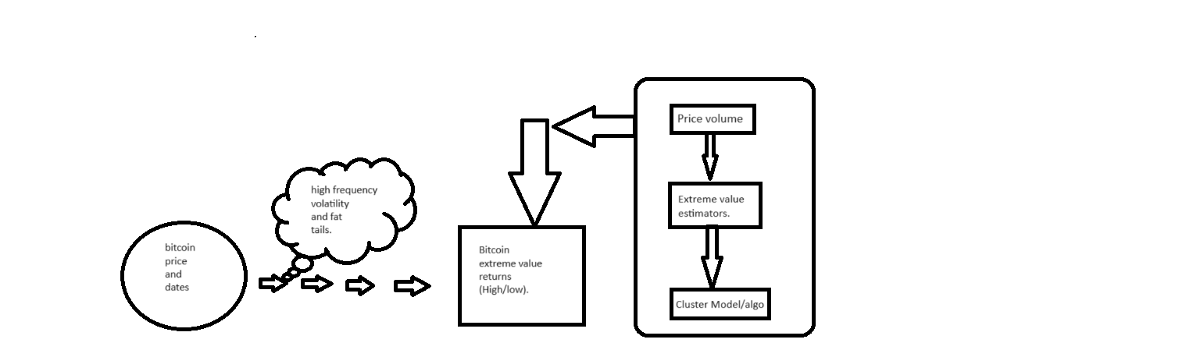
Conceptual framework

Slide 10
Methodology/Algorithm
Support Vector Machines (SVM)
Support Vector Machine (SVM) algorithm is utilized to predict the daily price movement of a cryptocurrency. (Initialization)The SVC class from scikit-learn is used to initialize an SVM classifier. (Training) The fit method is called to train the SVM classifier on the training set (x_train and y_train). The SVM model is trained, evaluated, and visualized in the provided code. The visualization helps in understanding how the SVM model separates the classes in the feature space.
The trained SVM classifier (clus) is used to make predictions on the test set (x_test) using the predict method.
confusion_matrix from scikit-learn is used to calculate the number of true positives, true negatives, false positives, and false negatives.
accuracy_score is used to calculate the accuracy of the SVM model.

Slide 11
Random Forest
(Initialization) The RandomForestClassifier class from scikit-learn is used to initialize a Random Forest classifier.
(Training) The fit method is called to train the Random Forest classifier on the training set (x_train and y_train). The trained Random Forest classifier (cla) is used to make predictions on the test set (x_test) using the predict method.
confusion_matrix from scikit-learn is used to calculate the number of true positives, true negatives, false positives, and false negatives.
accuracy_score is used to calculate the accuracy of the Random Forest model.

Slide 12
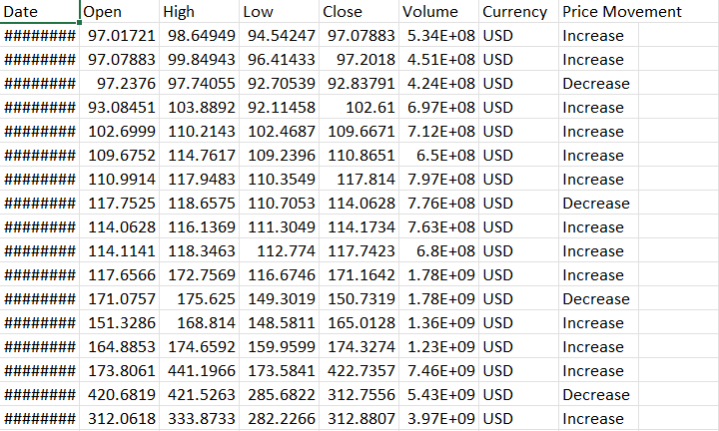
Inputs

Slide 13
Column Names and Descriptions:
1. Date: The date of the recorded prices.
2. Open: The opening price of the cryptocurrency on a given day.
3. High: The highest price reached by the cryptocurrency on that day.
4. Low: The lowest price reached by the cryptocurrency on that day.
5. Close: The closing price of the cryptocurrency on a given day.
6. Volume: The trading volume of the cryptocurrency on that day.
7. Currency: The currency denomination, assumed to be USD in this case.
8. Price Movement: The target variable indicating whether the closing price increased or decreased compared to the opening price.

Slide 14
Tools/Technologies
Tool: pycharm community edition 2023.1.2
Python: Writing scripts and implementing machine learning models.
Pandas: A data manipulation library for Python that provides data structures like data frames. Loading, cleaning, and preprocessing datasets.
Matplotlib and Seaborn: Visualization libraries for Python. Plotting graphs and charts to visualize data and model performance.
Scikit-learn Library: A collection of tools for data mining and data analysis. Implementing machine learning algorithms and utilities.
NumPy :NumPy is widely used in various scientific and engineering fields for numerical computations and data analysis due to its efficiency and versatility.

Slide 15
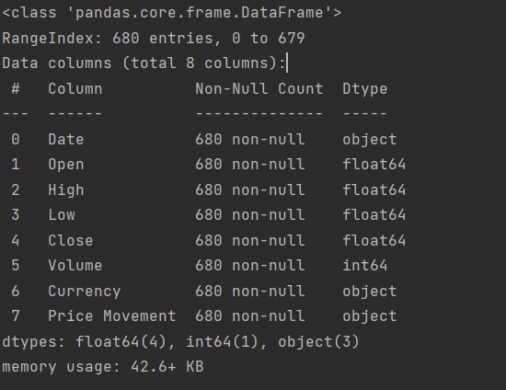
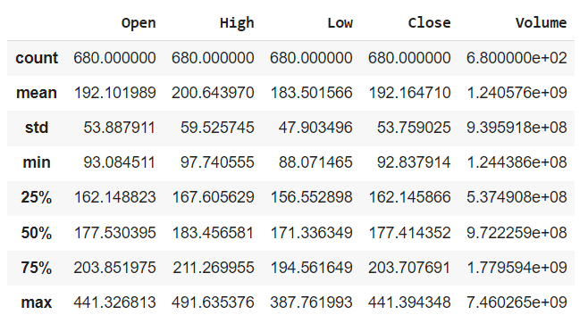
Implementation
Understanding the dataset and data cleaning

Slide 16
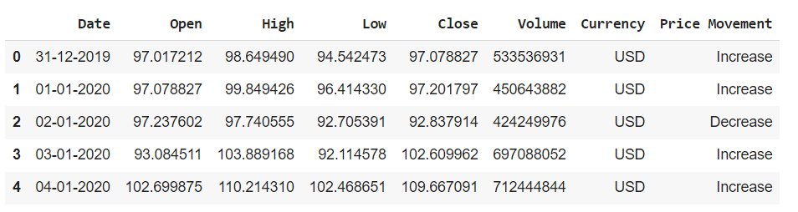
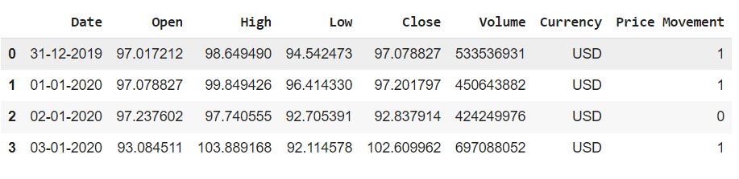

Slide 17
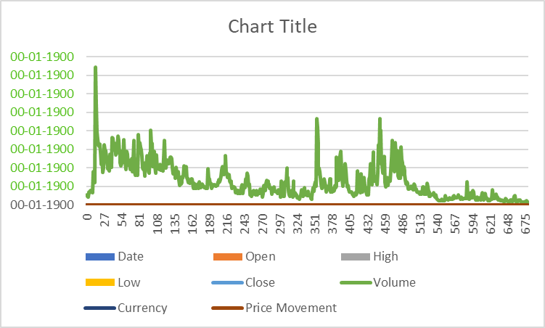
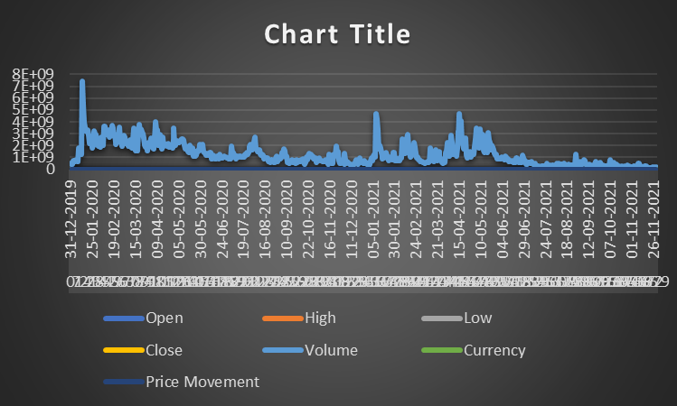

Slide 18
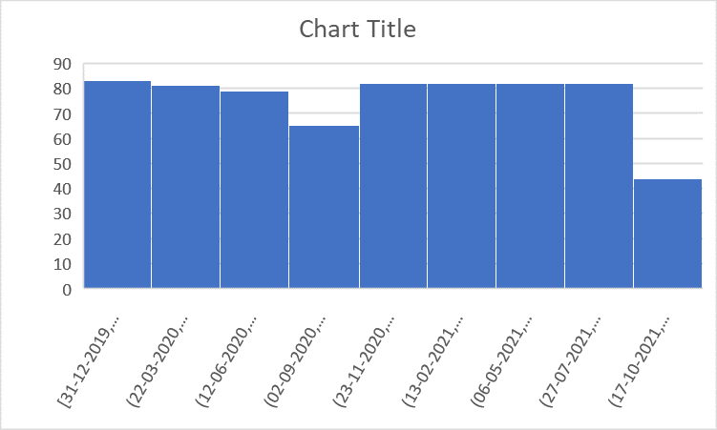
HISTOGRAM

Slide 19
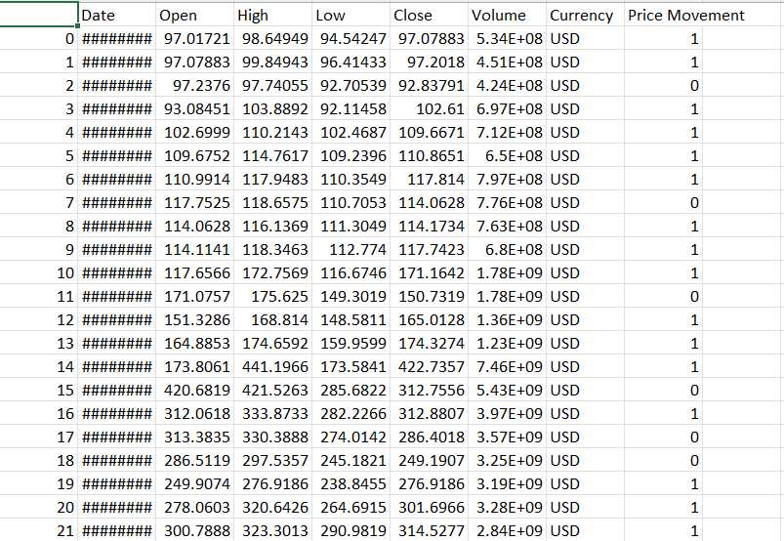
Results

Slide 20
Results Analysis
0 31-12-2019 97.017212 98.649490 94.542473 97.078827 533536931 USD Increase
1 01-01-2020 97.078827 99.849426 96.414330 97.201797 450643882 USD Increase
2 02-01-2020 97.237602 97.740555 92.705391 92.837914 424249976 USD Decrease
3 03-01-2020 93.084511 103.889168 92.114578 102.609962 697088052 USD Increase
The numerical representation of price movement:
0 31-12-2019 97.017212 98.649490 94.542473 97.078827 533536931 USD 1
1 01-01-2020 97.078827 99.849426 96.414330 97.201797 450643882 USD 1
2 02-01-2020 97.237602 97.740555 92.705391 92.837914 424249976 USD 0
3 03-01-2020 93.084511 103.889168 92.114578 102.609962 697088052 USD 1

Slide 21
Reflection Notes
My internship provided me with opportunity to delve into machine learning. My exploration of machine learning tools and technologies revealed a dynamic landscape, where careful choices and integration of tools significantly impact the development and deployment of predictive models.my internship experience provided me with invaluable opportunities for my personal development as well. I am grateful for the challenges and learning experiences that have contributed to my growth, and I look forward to applying these newfound skills and insights in future endeavors.

Slide 22


Slide 23
THANK
YOU☺

